Slide 1
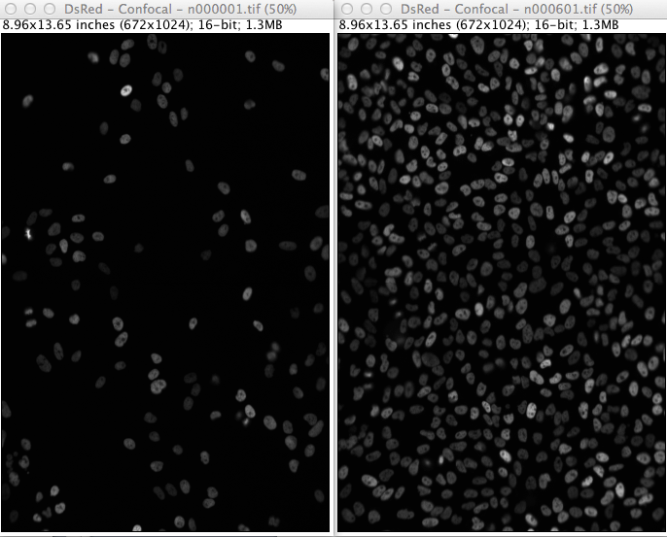
Background
How do we measure the cell overtime?
Manual vs. Automated
Can be accurate
Time consuming
Do you really want to track 600 image stack?
Different Algorithms
Can be accurate
Faster
Some are user friendly
Tend to be cell type and condition specific

Slide 2
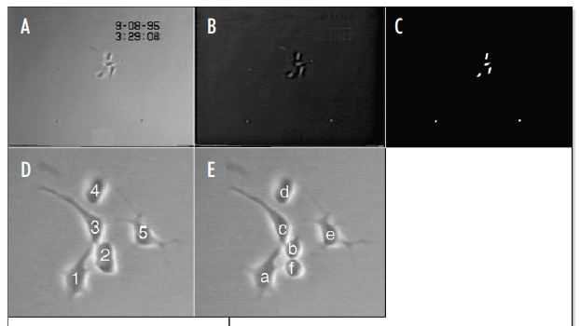
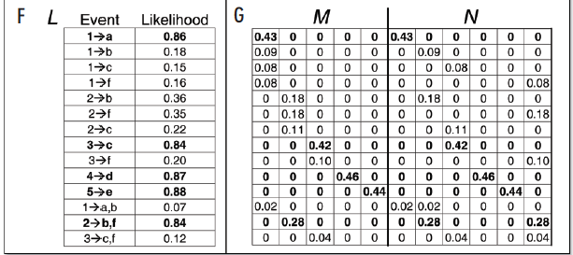

Background
Integer Programming (Al-Kofahi et al, 2006)
Modified Nearest Neighbor (CellAnimation)
Calculates the nearest between an object in one frame and an object in the next
Calculates the covariance of the distances
Calculates likelihood of a match based on distance and covariance
Assigns track based on maximum likelihood
Code can be found under CellAnimation/tracking

Slide 3
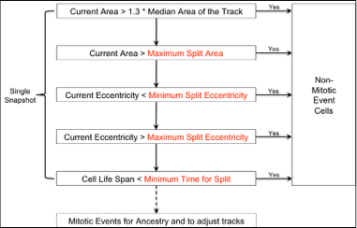
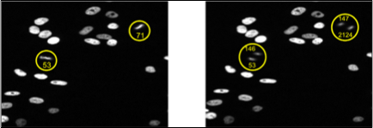
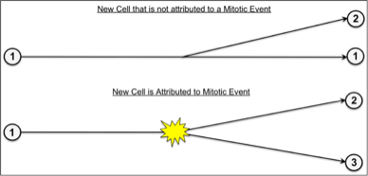
Background
Neither Is Perfect:
Al-Kofahi et al’s method works under their conditions but gets difficult with a large N (number of cells)
CellAnimation misses Mitotic Events and a great deal of time is spent correcting tracks

Slide 4
New Process
Segmentation
SegmentReview
Tracking
Naïve Bayes Classifier
Range Search
Binary Integer Programing
Track / Cell
Analysis
R Code
GUI ???

Slide 5
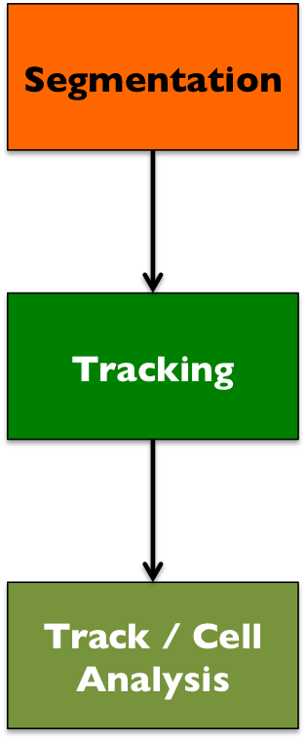
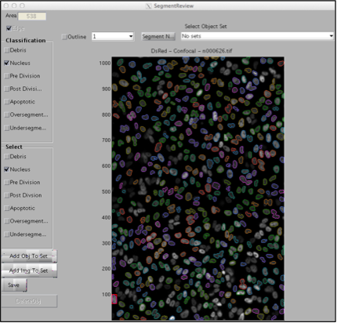
Segmentation
SegmentReview was created by Shawn Garbett and Sam Hooke
Create Training Set
Run NaïveSegmentation
Valid Segmentation with GUI
Convert to csv
Generate classifiers (uses boosted tree algorithm)
Segmentation
Segment Image Stack
Run NaïveSegmentation
Import Classifiers
Run LocalFinish
Run LocalGMMSegment
.mat file for each image

Slide 6
Tracking
1. Import / Extract data from .mat files
2. Naïve Bayes Classifier on each object
3. Build High Confidence Tracks
4. Conducts range search / calculates PDFs
5. Builds Integer Programming Matrix / Executes
6. Extract Selected Tracks
7. Generate Track ID numbers
8. Extract Mitotic Data
Tracking
Data is constantly exported in order for review if necessary

Slide 7
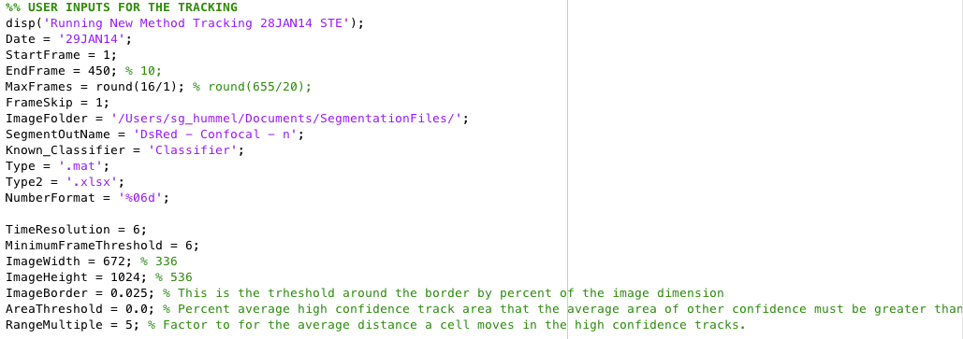
User Options

Slide 8
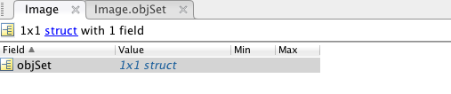
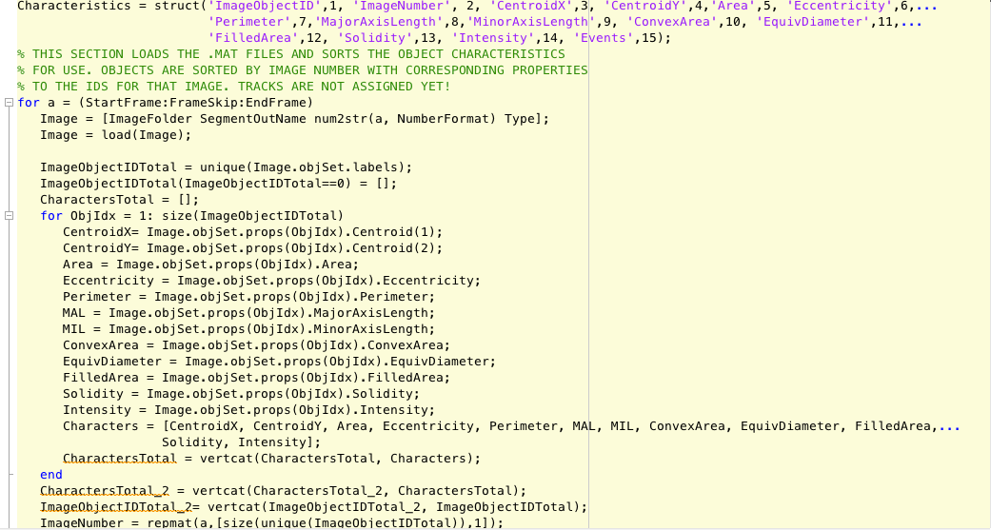
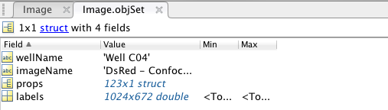
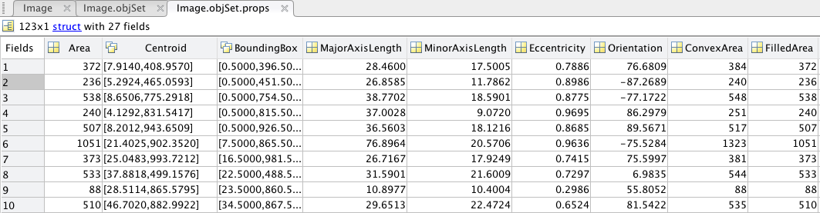
1. Import / Extract data from .mat files

Slide 9
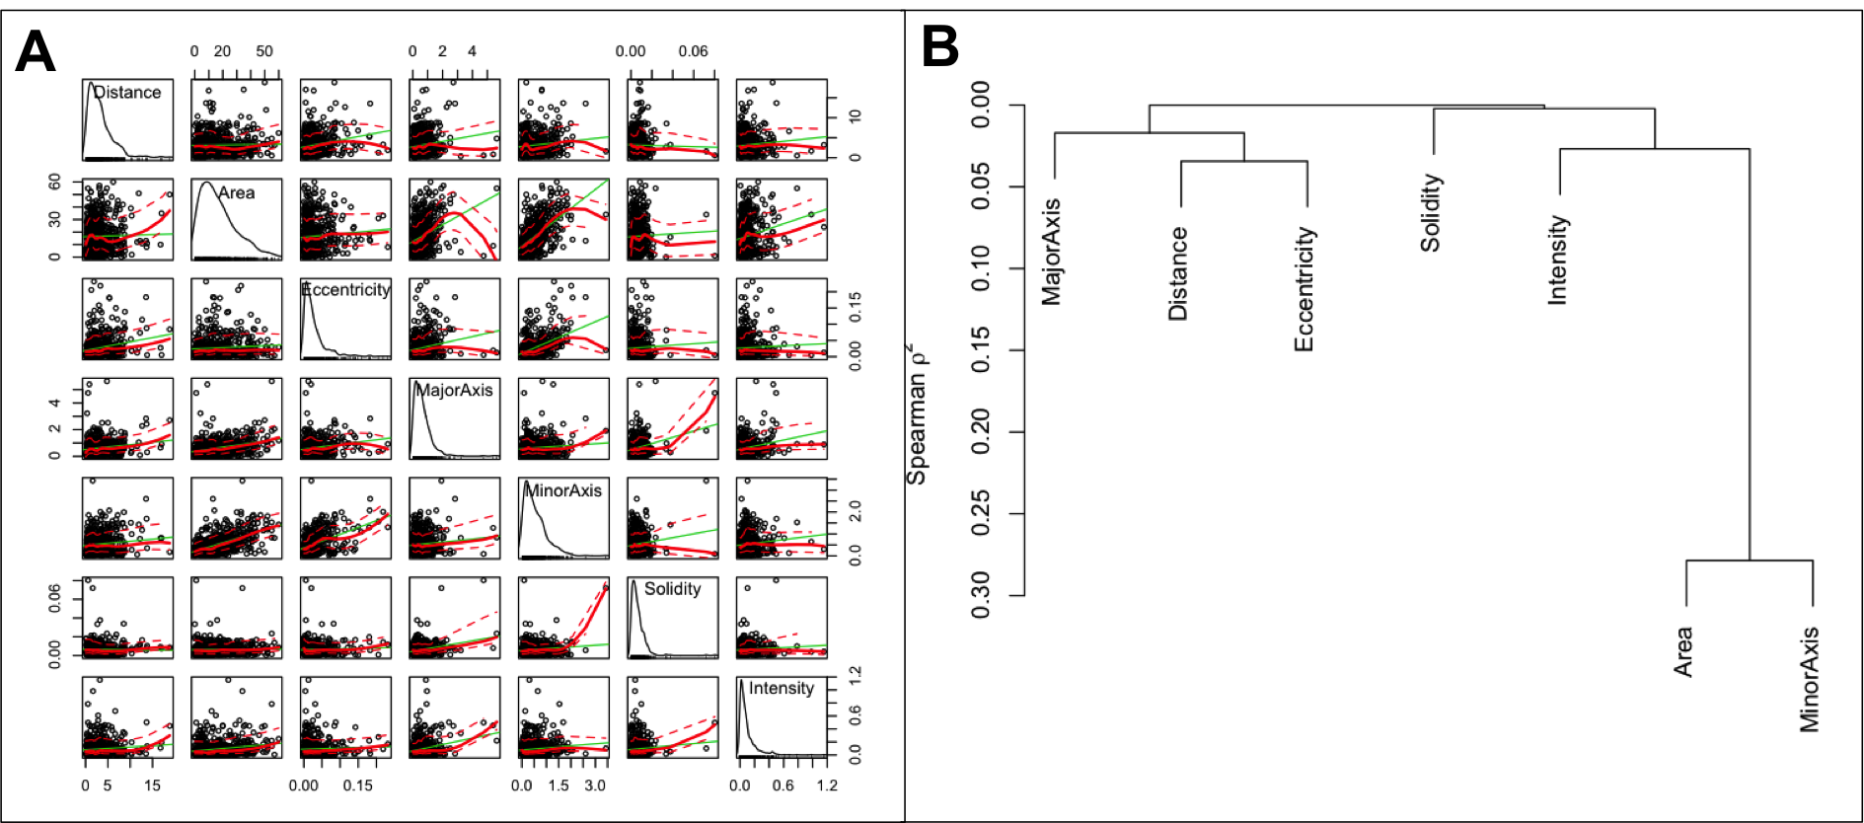
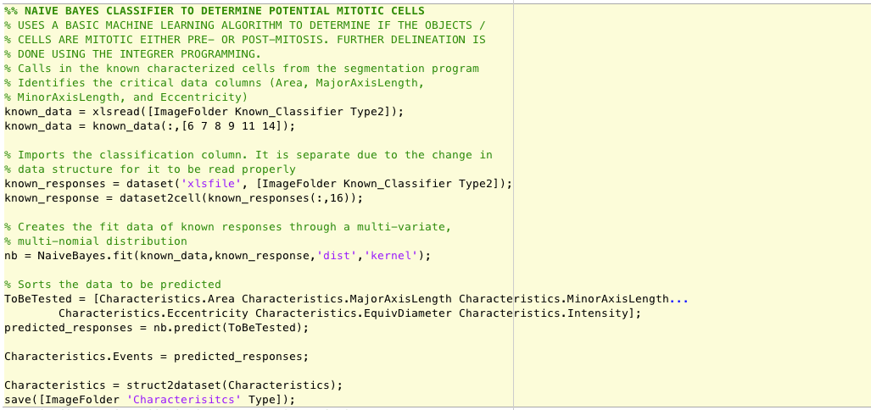
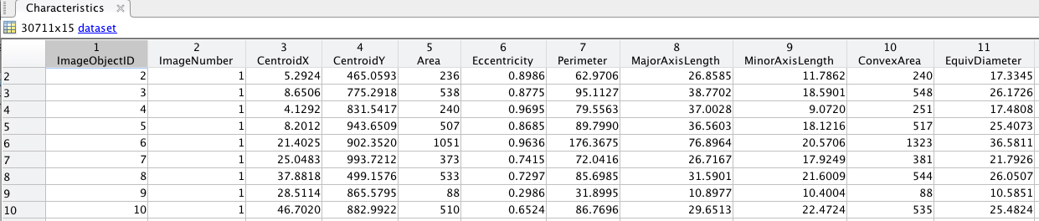
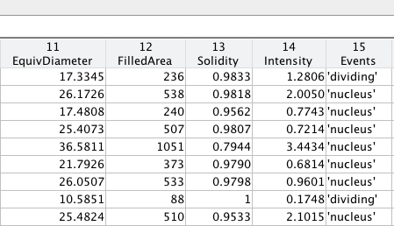
2. Naïve Bayes Classifier on each object
Area
Major Axis Length
Minor Axis Length
Eccentricity
Equivalent Diameter
Intensity

Slide 10
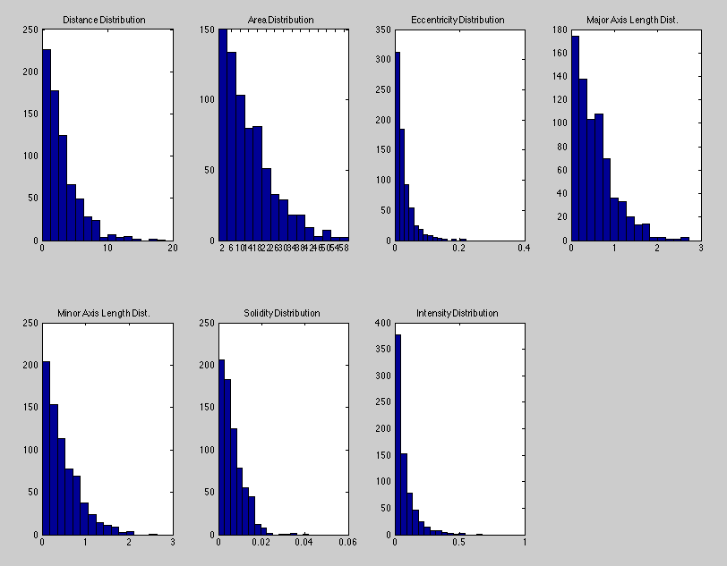
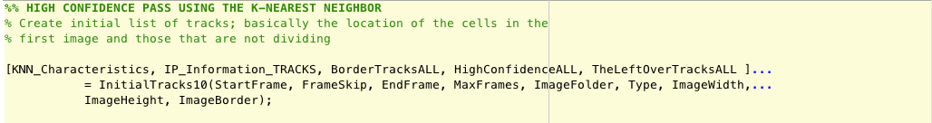
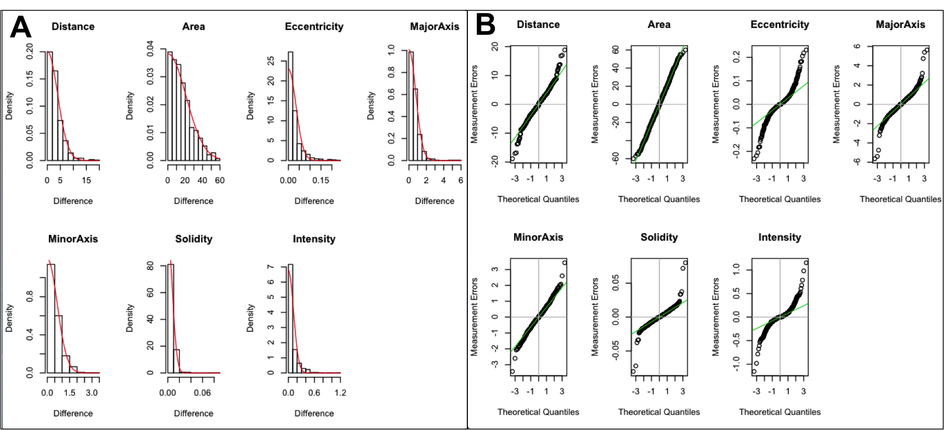
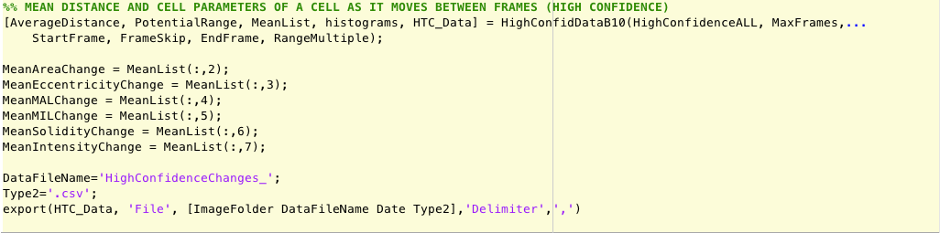
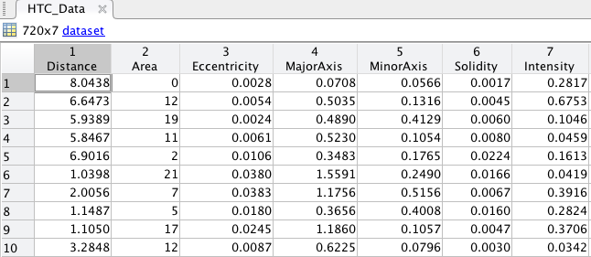
3. Build High Confidence Tracks
- Uses Matlab’s Nearest Neighbor Algorithm to generate the high confidence tracks
- The tracks must last the length of the time frame, not be dividing cells, and not be within 10% of the image edge

Slide 11


How Nearest Neighbor works?
Non-dividing
Dividing
1
1
11
12
1
2
11
12
11
12
2
3
13
2
13
13
14
3
4
14
4
3
4
14
5
15
5
15
5
15
6
7
16
6
7
16
6
7
16
17
18
17
18
17
18
8
8
8
9
19
20
9
9
20
19
20
19
10
21
10
21
10
21
1
11
12
t
1
11
12
t +1
t = MaxFrame
2
2
13
3
14
13
4
4
3
14
5
15
5
15
6
16
6
7
16
7
18
17
18
8
17
8
9
20
9
19
19
20
10
21
10
21

Slide 12
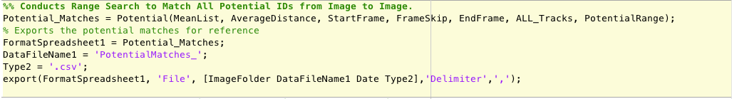
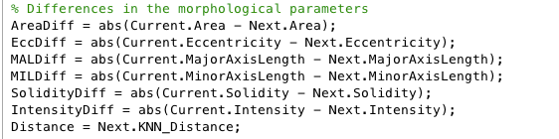
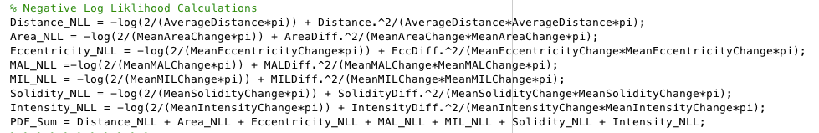
4. Conducts range search / calculates PDFs
Calculate Changes
Calculate Negative Log Likelihood
Sum Probability Distributions
1
1
11
12
1 → 1
2 → 1
2 → 2
11 → 11
5 → 4
5 → 5
7 → 7
7 → 16
7 → 17
2
11
12
3
13
2
13
4
14
14
4
3
5
15
5
15
6
7
16
6
16
18
7
18
8
17
17
20
8
9
19
9
21
19
20
10
10
21
Search Radius = Average Distance from High Confidence Tracks *
User Designated Value

Slide 13
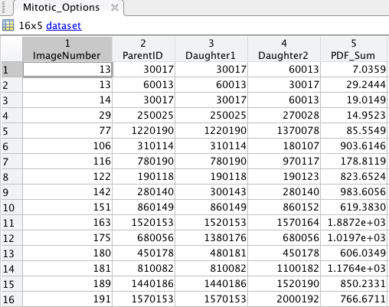
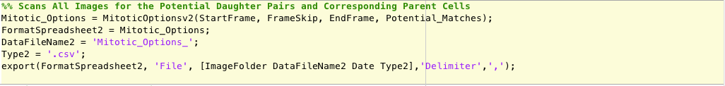
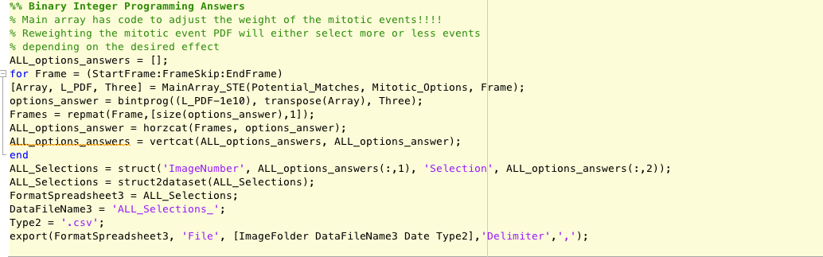
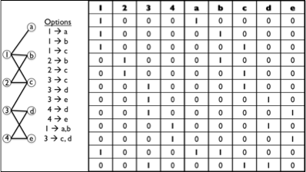
5. Builds Integer Programming Matrix / Executes

Slide 14
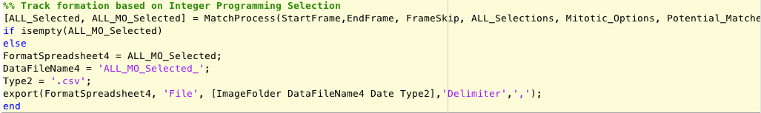
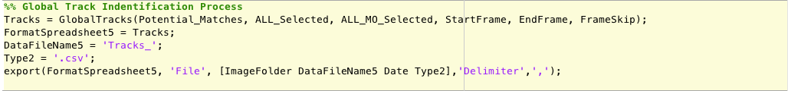
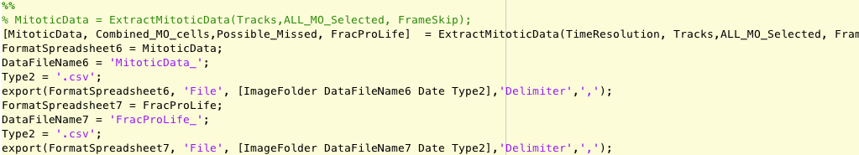
6. Extract Tracks and Mitotic Data
Indexes all the IP selections with the potential matches for all images
Generates the Track IDs based on selection and location
Tags dividing cells and cells that appear in the image
Reformats the data for FracProLife use

Slide 15
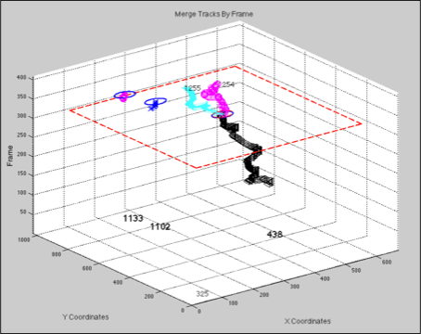
Future Improvements / Directions
1. New Mixed Integer Programming in MATLAB (updated)
2. High Confidence Auto-Merge Function (in-progress)
3. Refine the Integer Programming Weights
- distance is more important that morphological features
- other Parameters – Directionality? Turn Angle?
4. Graphical User Interface for image overlay and ease of use
Range search based on new cell X-, Y- location through previous 6 images for all tracks that ended.
Calculate PDFs for each option Integer Programming

